Slide 1
A GAME & GRAPH THEORETIC APPROACH TO CASCADING BEHAVIOR IN NETWORKS
By Ajay Mattappallil

Slide 2
Models for Marketing
Initial Release of Product
Need something to attract primary buyers
Incentives can vary depending on the individual
Started by listing all the factors that can influence a potential buyer

Slide 3
The most obvious factor that influences a potential buyer is the cost to the individual in purchasing the product.
By cost, we are encompassing both emotional and monetary cost. (embarrassment)
z(x_{h})

Slide 4
The next factor that naturally follows would be the gain the individual receives independently of the benefit he or she gains from his or her peers owning the product as well.
emotional and monetary values
investment
v(x_{h})

Slide 5
The gain that the individual receives from his or her peers owning the product as well.
∑ u(x_{h} , x_{j}) w(x_{h} , x_{j})r

Slide 6
Having the product partly marketed to you by your peer
y(x_{h} , x_{o})q

Slide 7
Incentive model ➔ I
I(x_{h}) = z(x_{h}) – v(x_{h}) – y(x_{h} , x_{o})q - [ ∑ u(x_{h} , x_{j}) w(x_{h} , x_{j})r ]

Slide 8
Other Models
G(x_{h}) → Overall Gain to Individual
C(x_{h}) → Cost to Company for x_{h}
P(x_{h}) → Profit for Company from x_{h}

Slide 9
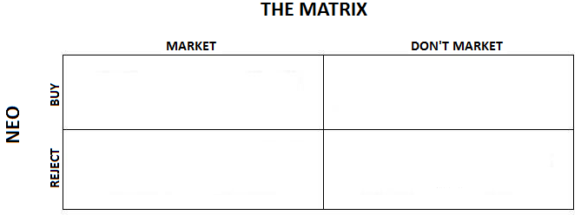
Payoff Matrix
( G(x_{h})+ I(x_{h}), P(x_{h}) )
( G(x_{h}), P(x_{h}) + C(x_{h}) – M/k )
( z(x_{h}) , -C(x_{h}) ))
( z(x_{h}) , -M/k)

Slide 10
Mixed Strategy
EV(Buy) = EV(Reject)
P(x_{h})P_{1A} + -C(x_{h})(1- P_{1A} ) = {P(x_{h}) + C(x_{h}) – M/k} P_{1A} + -M/k(1- P_{1A} )
P_{1A} = (-C(x_{h})- -M/k) / [({P(x_{h}) + C(x_{h}) – M/k} - -M/k) - (P(x_{h})- -C(x_{h}))]
P_{1A} = (-C(x_{h})- -M/k) / 0
P_{1A} = Undefined
Nash Equilibrium (optimal strategy)
necessary to apply values to functions through data

Slide 11
Graph Approaches
Eulerian paths
Instead of attempting to reach every node once, we can at least optimize exhausting all possible edges (opportunites) to convert a node.
2 or no odd vertices
Subtract edges or entire nodes if necessary
Infeasible to add

Slide 12
Another Approach
Dominating sets?
Instead, use simple algorithm to list nodes in order of highest to lowest degree.

Slide 13
HORRAYYYY!! I DID IT!
wooooooooooooooooooooooooooooooooooooooooooooooooooooooooooooooooooooooohooooooooooooooooooooooooooooooooooooooooooooooooooooooooooooooooooooooooooooooooooooooooooo

